Slide 1
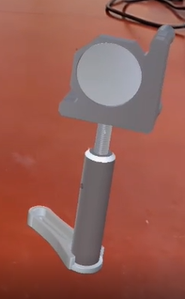
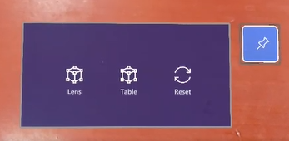
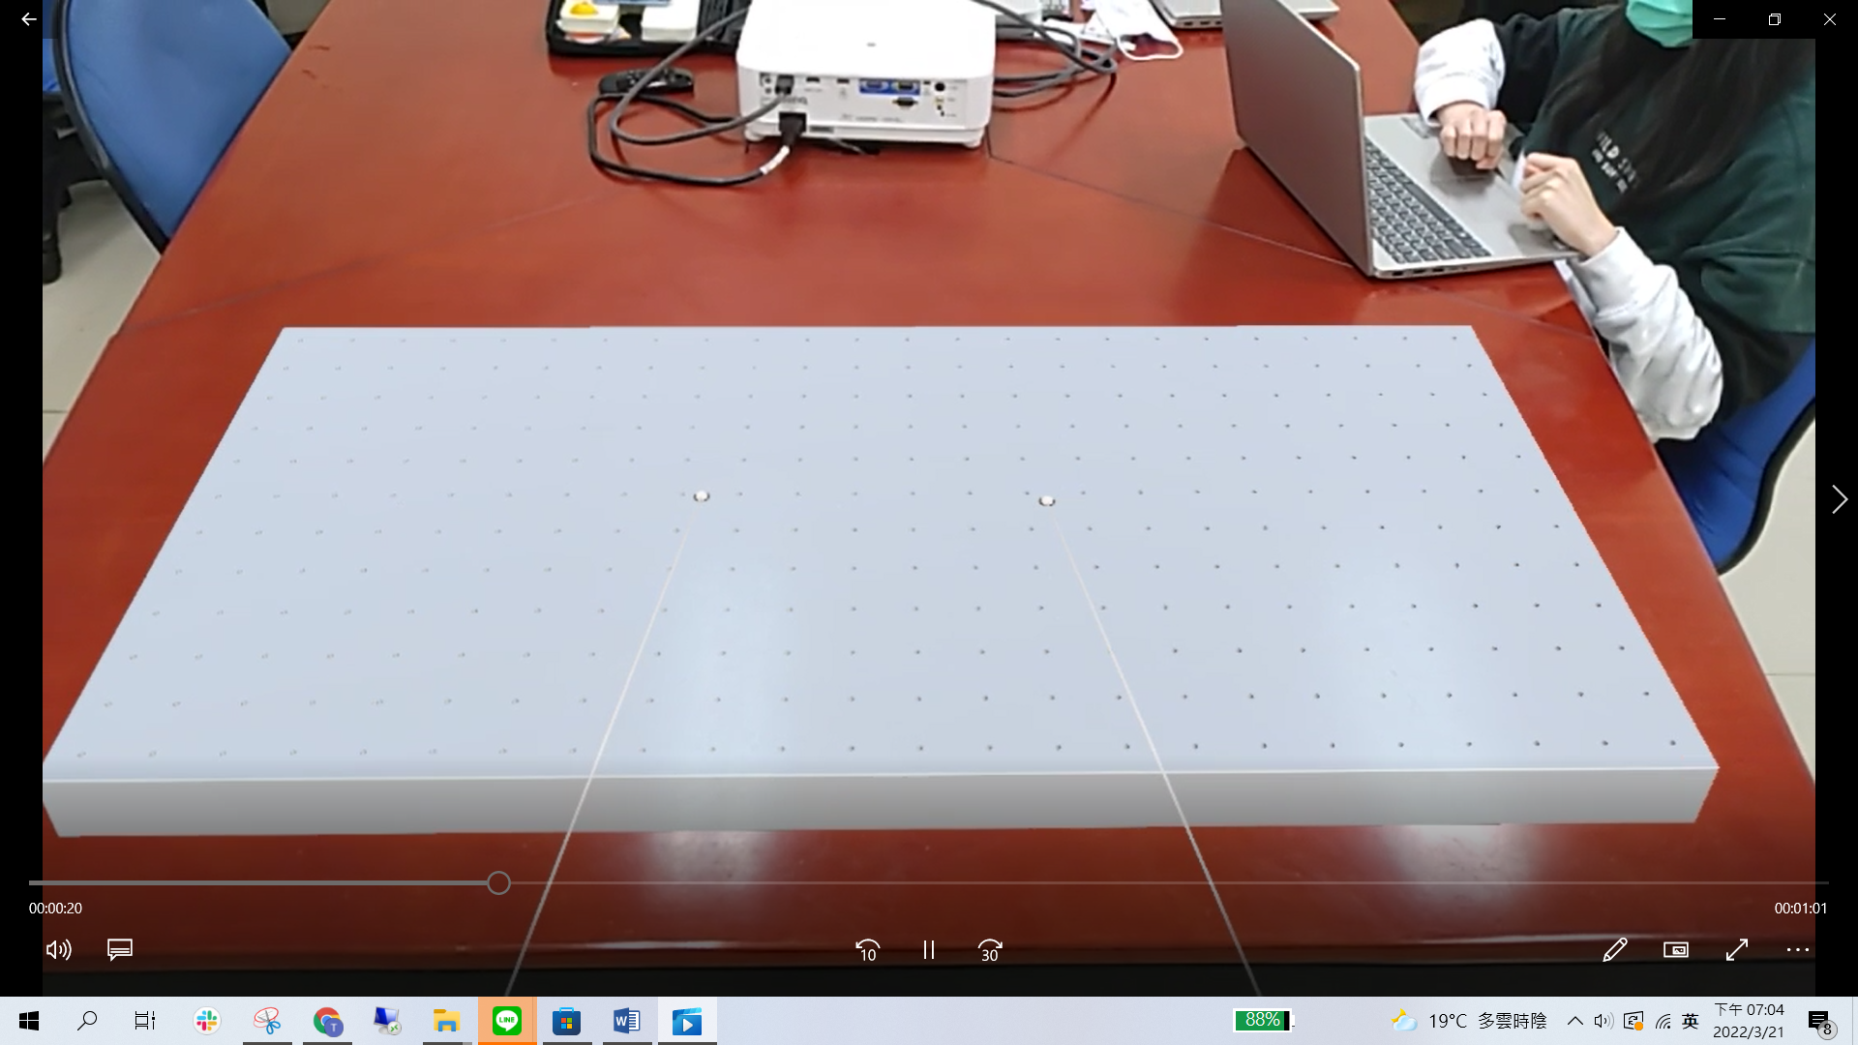
生成光學透鏡
清除所有物件
釘選按鈕列表位置
生成光學桌

Slide 2
生成光學透鏡
清除所有物件
釘選按鈕列表位置
生成光學桌

Slide 3
 | Without optimization |  |  | With optimization
 | CPU(%) | GPU(%) | System Frame rate | CPU(%) | GPU(%) | System Frame rate
One object | 14% | 32% | 339 FPS | 11% | 32% | 208 FPS
Two objects | 17% | 40% | 230 FPS | 11% | 30% | 172 FPS
Three objects | 20% | 40% | 177 FPS | 12% | 30% | 145FPS
Four objects | 22% | 36% | 127 FPS | 13% | 29% | 126 FPS
Five objects | 24% | 35% | 104 FPS | 13% | 28% | 92 FPS
 | Without optimization |  |  | With optimization
 | CPU(%) | GPU(%) | System Frame rate | CPU(%) | GPU(%) | System Frame rate
One user | 18% | 43% | 210 FPS | 13% | 35% | 187 FPS
Two users | 22% | 42% | 128 FPS | 13% | 38% | 122 FPS
Three users | 25% | 43% | 89 FPS | 13% | 40% | 87 FPS
Four users | 33% | 41% | 62 FPS | 14% | 38% | 71 FPS

Slide 4
 | With optimization
 | CPU(%) | GPU(%) | System Frame rate
One object | 16% | 16% | 30 FPS
Two objects | 19% | 13% | 23 FPS
Three objects | 22% | 10% | 18 FPS
Four objects | 25% | 7% | 13 FPS
Five objects | 28% | 5% | 6 FPS

Slide 5
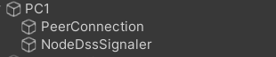

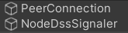

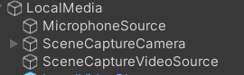
Signaling Server
Signaling
Signaling
Signaling
Unity server
Local peer ID:UNITY
Remote peer ID:PC1
User1
Local peer ID:UNITY
Remote peer ID:PC2
Media
Local peer ID:PC1
Remote peer ID:UNITY
User2
Media
Local peer ID:PC2
Remote peer ID:UNITY

Slide 6
Signaling Server
Signaling
Signaling
Signaling
Unity server
Local peer ID:UNITY1
Remote peer ID:PC1
User1
Local peer ID:UNITY2
Remote peer ID:PC2
Media
Local peer ID:PC1
Remote peer ID:UNITY1
User2
Media
Local peer ID:PC2
Remote peer ID:UNITY2

Slide 7
Signaling Server
Signaling
Signaling
Signaling
Unity server
Local peer ID:UNITY
Remote peer ID:
User1
動態生成
Media
Local peer ID:PC1
Remote peer ID:UNITY
Media
User2
Local peer ID:PC2
Remote peer ID:UNITY

Slide 8
Signaling Server
Signaling
Signaling
Signaling
Unity server
Local peer ID:UNITY
Remote peer ID:
User1
Local peer ID:PC1
Remote peer ID:UNITY
動態生成
Media
User2
Local peer ID:PC2
Remote peer ID:UNITY
Media

Slide 9
Signaling Server
Signaling
Signaling
Signaling
Unity server
Local peer ID:UNITY
Remote peer ID:
User1
Local peer ID:1
Remote peer ID:UNITY
動態生成
Local peer ID:UNITY_PC1
Remote peer ID:PC1
Local peer ID:PC1
Remote peer ID:UNITY_PC1
Media
User2
Local peer ID:2
Remote peer ID:UNITY
Local peer ID:UNITY_PC2
Remote peer ID:PC2
Media
Local peer ID:PC2
Remote peer ID:UNITY_PC2

Slide 10
Unity Server
Signal Server
Client1
Client2
Send
PC1
Send
PC1
Connect
Connect(Send1)
Connect(PC1)
Connect(Send2)
Connect(PC2)
Create PeerConnection
Add Streams
Send Offer SDP
Create Offer
Relay Offer SDP
Unity_PC1
Connect
Create PeerConnection
Add Streams
Create Offer
Send Offer SDP
Relay Offer SDP
Create Answer
Relay Answer SDP
Send Answer SDP
Send Candidate
Relay Candidate
Add Candidate
Relay Candidate
Send Candidate
Create PeerConnection
P2P Connect
Add Streams
Send Offer SDP
Create Offer
Relay Offer SDP
Unity_PC2
Connect
Create PeerConnection
Add Streams
Create Offer
Send Offer SDP
Relay Offer SDP
Create Answer
Relay Answer SDP
Send Answer SDP
Send Candidate
Relay Candidate
Add Candidate
Relay Candidate
Send Candidate
P2P Connect

Slide 11
Unity Server
Signal Server
Client1
Client2
Send
User1
Send
User1
Connect
Connect(Send1)
Connect(User1)
Connect(Send2)
Connect(User2)
Relay Offer SDP
Send Offer SDP
Unity_User1
Connect
Send Offer SDP
Relay Offer SDP
Relay Answer SDP
Send Answer SDP
Create Answer
P2P Connect
Relay Offer SDP
Send Offer SDP
Unity_User2
Connect
Send Offer SDP
Relay Offer SDP
Create
Answer
Relay Answer SDP
Send Answer SDP
P2P Connect

Slide 12
Unity Server
Signal Server
Client1
Client2
Send
User1
Send
User2
Relay Offer SDP
Send Offer SDP
Unity_User1
Connect
Send Offer SDP
Relay Offer SDP
Relay Answer SDP
Send Answer SDP
Create
Answer
P2P Connect
Relay Offer SDP
Send Offer SDP
Unity_User2
Connect
Send Offer SDP
Relay Offer SDP
Create
Answer
Relay Answer SDP
Send Answer SDP
P2P Connect

Slide 13
Client1
Client2
Signal Server
Unity Server
Send
User1
Send
User2
Send Offer SDP
Unity_User1
Connect
Relay Offer SDP
Send Offer SDP
Create
Answer
Send Answer SDP
Relay Answer SDP
P2P Connect
Unity_User2
Connect
Create
Answer
Send Answer SDP
Relay Offer SDP
P2P Connect

Slide 14
Unity Server
Signal Server
Client1
Client2
Send
User1
Send
User2
Connect
Connect(Send1)
Connect(User1)
Connect(Send2)
Connect(User2)
Relay Offer SDP
Send Offer SDP
User1 Prefab
Connect
Send Offer SDP
Relay Offer SDP
Relay Answer SDP
Send Answer SDP
Create Answer
P2P Connect
Relay Offer SDP
Send Offer SDP
User2 Prefab
Connect
Send Offer SDP
Relay Offer SDP
Create
Answer
Relay Answer SDP
Send Answer SDP
P2P Connect

Slide 15
Client2
Client1
Signal Server
Unity Server
User2
Send
User1
Send
Send Offer SDP
Relay Offer SDP
User1 Prefab
Connect
Relay Offer SDP
Send Offer SDP
Create
Answer
Send Answer SDP
Relay Answer SDP
P2P Connect
Send Offer SDP
Relay Offer SDP
User2 Prefab
Connect
Relay Offer SDP
Send Offer SDP
Create
Answer
Send Answer SDP
Relay Answer SDP
P2P Connect

Slide 16
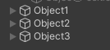
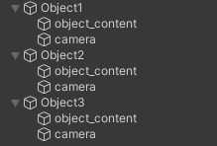
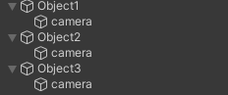
目前單人server架構
目前多人server架構
Unity server
負責Media傳輸
Unity server
只負責接收ID
User
負責Media傳輸
動態生成(程式執行後才生成)
…

Slide 17
User1
1.使用者改變物件位置
(判斷到物件位置改變將傳送資訊)
2.傳送改變資訊
3.Server將收到的資訊對該物件進行更新
Server
4.將更新後的資訊傳給其他使用者
5.接收到更新的資訊對物件進行改變
User2
6.由於更新後，物件位置改變了，因此又會把user1改變的過程再傳回去。

Slide 18




User1
send events
receive events
modify
send events
User2
receive events
receive events
send events
User3

Slide 19
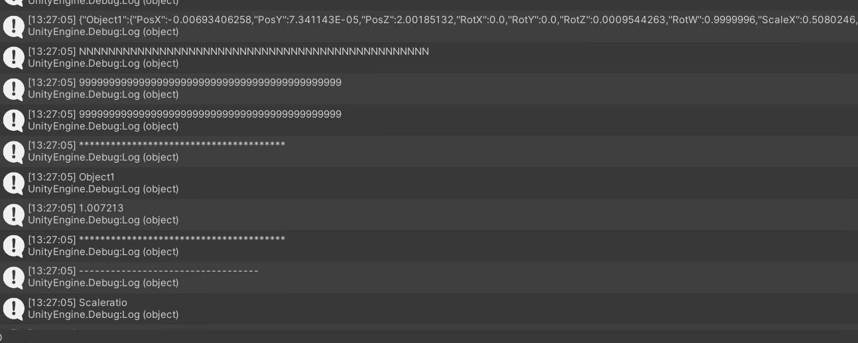
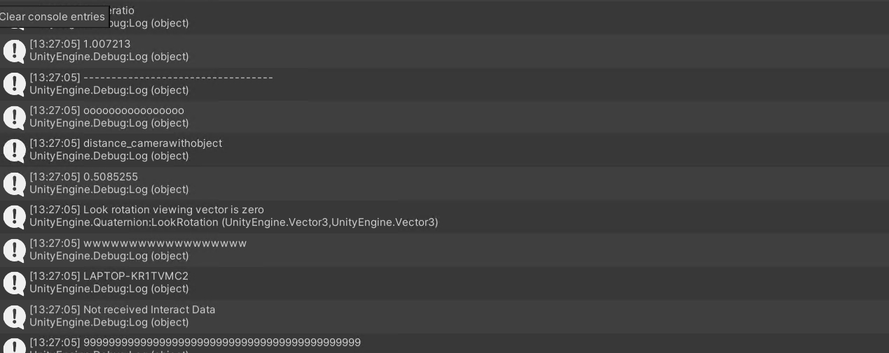
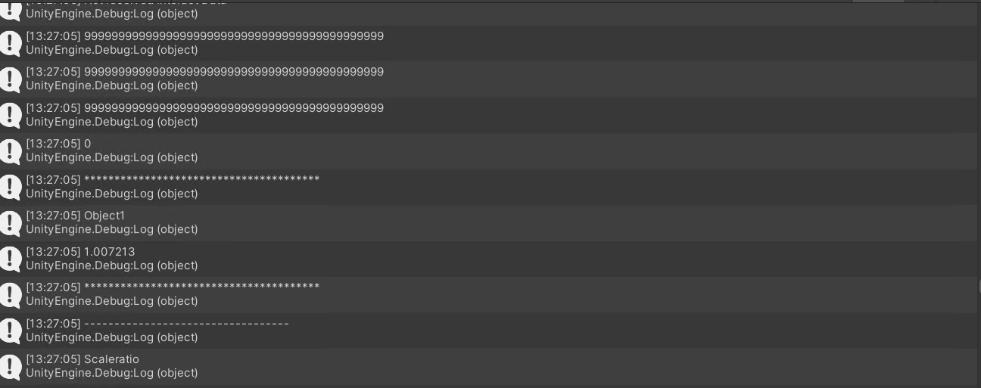
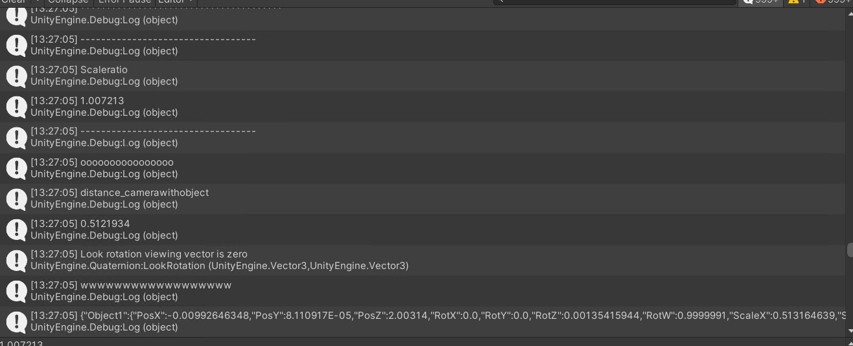

Slide 20
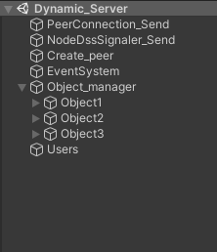
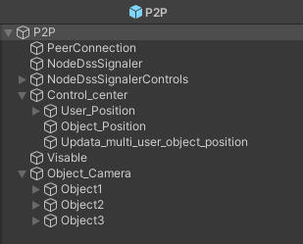


目前單人server架構
目前多人server架構
Unity server
P2P(USER)預先設定
連線物件(接收ID)
連線物件
(回傳ID及media傳輸)
物件相關
資訊
User1(裝置名稱)
User2(裝置名稱)
物件相機
…
使用者連線後生成

Slide 21
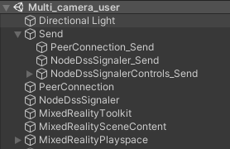
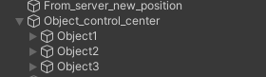
目前單人server架構
目前多人server架構
Unity client
連線物件(發送使用者ID)
連線物件(接收ID及media傳輸)
每個物件播放器

Slide 22
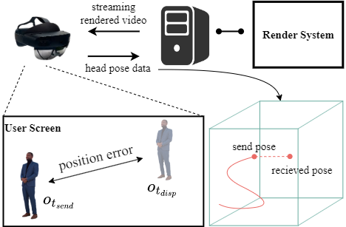


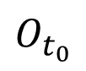
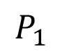
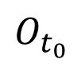
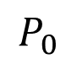
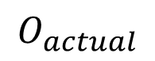
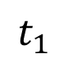
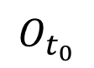
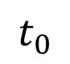
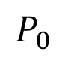
$$t_{0}$$
$$t_{1}$$
$$O_{actual}$$
$$O_{t_{0}}$$
$$O_{t_{0}}$$
Position error
$$P_{0}$$
$$P_{1}$$
Head pose data
Streaming video
$$P_{0}$$
$$O_{t_{0}}$$
Server
rendering frame

Slide 23
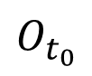
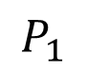
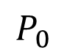
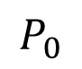
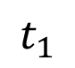
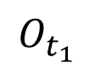
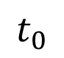
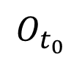
$$t_{0}$$
$$O_{t_{0}}$$
Head pose data
$$t_{1}$$
$$P_{0}$$
$$P_{0}$$
$$O_{t_{1}}$$
$$O_{t_{0}}$$
Server
$$P_{1}$$
Streaming video

Slide 24






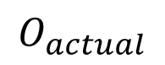
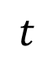
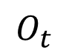
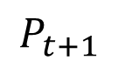
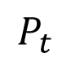
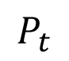
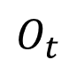
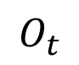
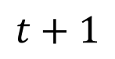
$$t$$
$$t+1$$
$$O_{t}$$
$$O_{actual}$$
$$O_{t}$$
Position error
$$O_{t}$$
$$P_{t}$$
$$P_{t+1}$$
Server
Streaming video
$$P_{t}$$
Head pose data
move

Slide 25
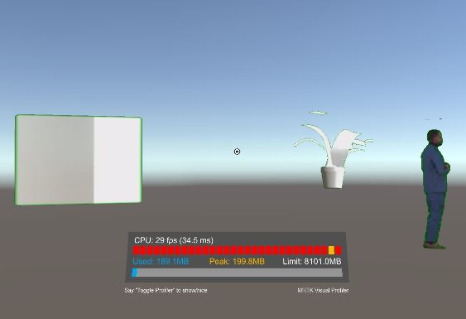
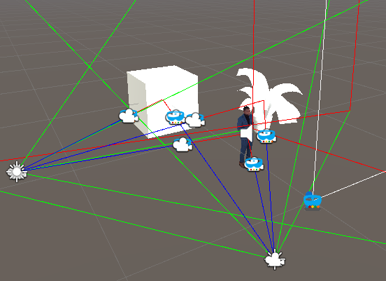
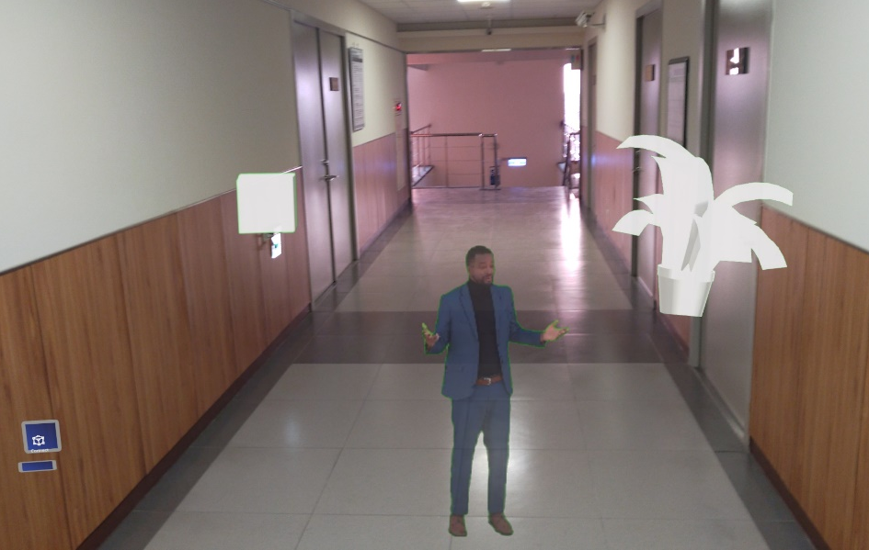
User1 (使用螢幕)
User1
User1 object camera
User2 object camera
User2
User2 (使用MR 眼鏡)
Server

Slide 26
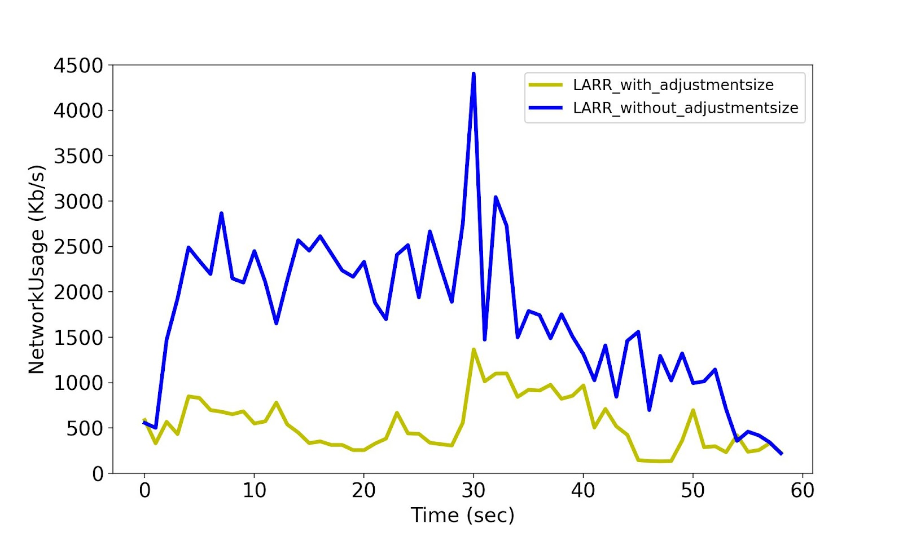
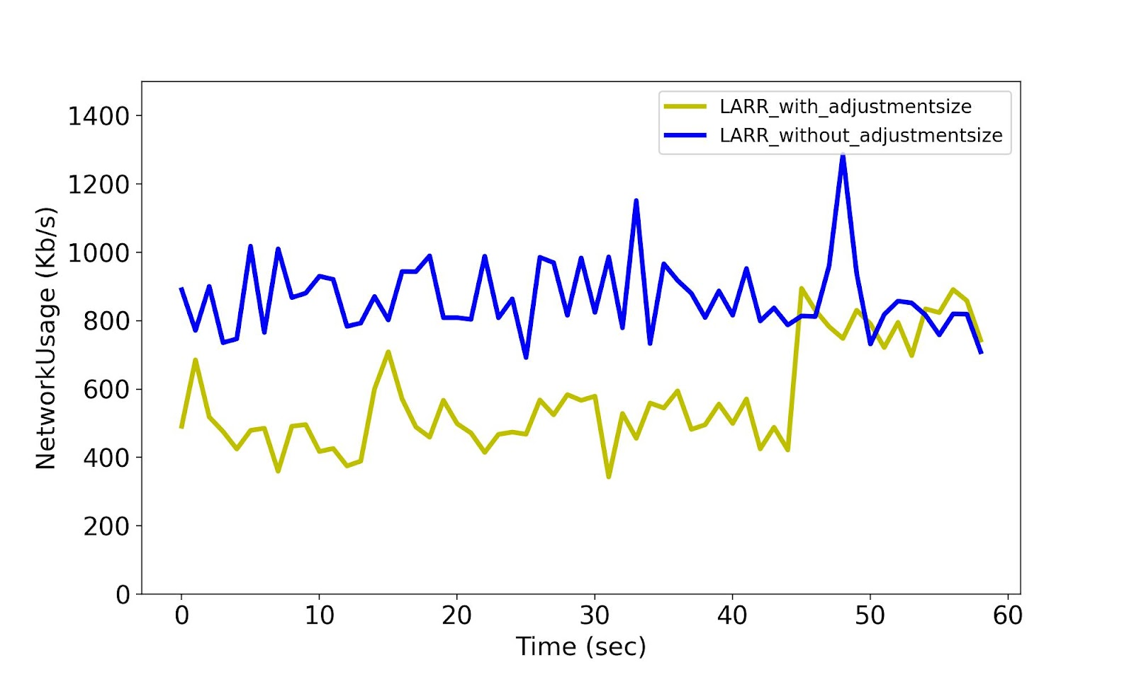
Combine
SizeRatio = 0.1
SizeRatio = 0.2
SizeRatio = 0.3
SizeRatio = 1

Slide 27

Signaling Server
Object Input
Render
HTTP Connection
Cluster
Volumetric
Object
RTC Peer
Connection
HTTP Connection
Object Input
Render
User Pose
Camera
RTC Peer
Connection
RTC Peer
Connection
Visible
Cluster
Volumetric
Object
Merge
User Pose
Camera
RTC Peer
Connection
RTC Peer
Connection
Adjust Size
Visible
Merge
RTC Peer
Connection
Object Streaming Camera
Adjust Size
Object Streaming Camera

Slide 28

HTTP Connection
User Input
Application
Logic
User Information
RTC Peer
Connection
Object Information
Display
Rendering
Adjustment
Texture
Decoding

Slide 29
High
Throughput
High resolution
Do not execute Merge
Good conditions, no further optimization is needed to maintain accurate object positioning
High resolution
Do not execute Merge
With high latency, executing the merge will result in object shaking
With a high throughput, it allows for high transmission volume
Low
Latency
High
Latency
Low resolution
Execute the merge
To further minimize the total amount of transmitted data
Low resolution
Do not execute Merge
With high latency, the inaccurate merging of object positions
With low throughput, compared to the issue of incorrect screen display, has a relatively smaller impact
Low
Throughput

Slide 30
High
Throughput
 | With | Without | Optional
Merge |  |  | ●
Resolution |  |  | ●
 | With | Without | Optional
Merge |  | ●
Resolution |  |  | ●
Merge
Good conditions ➔ Accurate object positioning
Resolution
Good conditions ➔ Optional
Merge
Merge with high latency ➔ Object shaking
High throughput ➔ High transmission volume
Resolution
Good conditions ➔ Optional
Low
Latency
High
Latency
 | With | Without | Optional
Merge | ●
Resolution | ●
 | With | Without | Optional
Merge |  | ●
Resolution | ●
Merge
Low latency ➔ Object shaking low
Minimize the amount of data
Resolution
Low throughput ➔ Minimize the amount of data
Merge
Merge with high latency ➔ Object shaking
With low throughput ➔ incorrect screen content display, the impact is relatively small
Resolution
Minimize the amount of data
Low
Throughput

Slide 31
Signaling Server
Render
HTTP Connection
HTTP Connection
User Input
Application
Logic
User Pose Information
RTC Peer
Connection
RTC Peer
Connection
Cluster
Object Manager
Object Update Information
User Pose
Camera
Object1
RTC Peer
Connection
Visible
Object2
Display
Adjustment
Texture
Decoding
Update Object
Merge
Object3
RTC Peer
Connection
Adjust Size
Object Streaming Camera

Slide 32
Signaling Server
Signaling data
Signaling data
Server
HTTP Connection
User N-1 Client
User N-1 prefab
Compare & Update
RTC Peer
Connection
User N Client
HTTP Connection
Control Center
Object Streaming Camera
Object Manager
User Input
Control Center
User N prefab
Cluster
Application
Logic
User Pose Information
RTC Peer
Connection
RTC Peer
Connection
Object1
Object Update Information
Object2
Control Center
Object Streaming Camera
Object3
Display
Adjustment
Texture
Decoding
Update Object
User N+1 prefab
RTC Peer
Connection
User N+1 Client
Control Center
Object Streaming Camera
Control Center
Optimizer
User Pose
Camera
Visible
Merge
Adjust Resolution

Slide 33



Slide 34








Slide 35
User1
position camera
User2
position camera

Slide 36
Camera position

Slide 37
Camera position
Camera position

Slide 38
Camera position

Slide 39
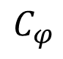








Client
Server
$$O$$
$$O$$
User Screen
Player
$$O$$
$$y$$
$$C_{θ}$$
$$C_{φ}$$
$$z$$
$$x$$
$$C$$
$$U$$

Slide 40





Client
Player
Player
Server
$$O$$
$$O$$
User Screen
$$y$$
$$C_{θ}$$
$$z$$
$$C_{φ}$$
$$x$$
$$C$$
$$U$$
$$U$$

Slide 41





Slide 42




1080*1080
270*270
transfer to client
User Screen
540*540
resize
transfer to client
1080*1080
1080*1080
resize
(a)
(b)

Slide 43

1080*1080
270*270
transfer to client
User Screen
540*540
resize
transfer to client
1080*1080
1080*1080
resize
(a)
(b)

Slide 44



1080*1080
270*270
transfer to client
User Screen
540*540
resize
transfer to client
1080*1080
1080*1080
resize
(a)
(b)

Slide 45
User Screen
Object Streaming Camera
Object Streaming Camera
(b)
(c)
(a)

Slide 46
User1
position camera

Slide 47
Server
Object streaming camera
User1’s object camera
User2‘s object camera
Control data
User1
Media stream
User1’s
pose camera
Media stream
Server
Control data
User2’s
pose camera
User2

Slide 48
Server
Object streaming camera
User1’s object camera
User2‘s object camera
Control data
User1
Media stream
User1’s
pose camera
Media stream
Server
Control data
User2’s
pose camera
User2

